Slide 1


FEATURE ANALYSIS AND
PRICE PREDICTION FOR HANDSETS
Presentation by Darshika Dudhat

Slide 2



PROBLEM STATEMENT
WORKFLOW
Objective: Develop a predictive model to estimate handset prices based on their features, helping the organization refine its pricing strategy amidst rising market competition.
Insight Generation: Identify key features influencing handset pricing to provide actionable insights for optimizing marketing and pricing strategies.
DATA EXPLORATION
DATA
PRE-PROCESSING
FEATURE ANALYSIS
& EXTRACTION

Slide 3
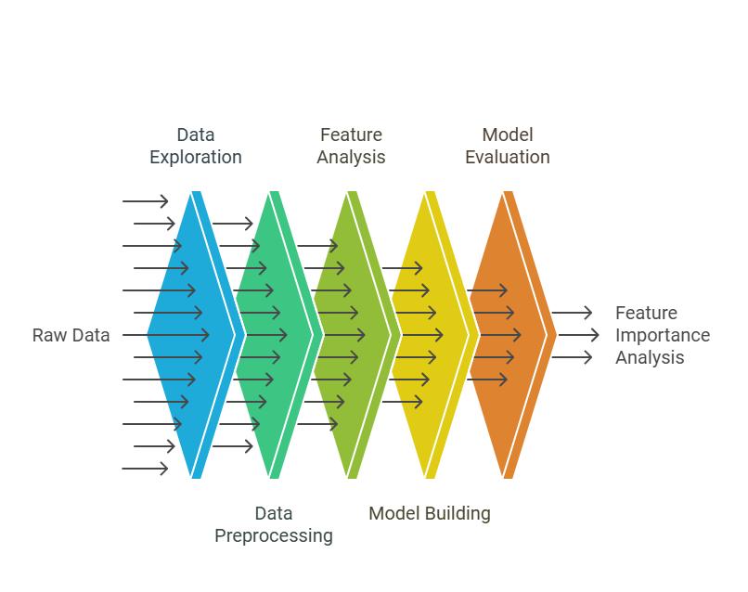
PROBLEM STATEMENT
WORKFLOW
DATA EXPLORATION
DATA
PRE-PROCESSING
FEATURE ANALYSIS
& EXTRACTION

Slide 4

PROBLEM STATEMENT
In the raw data,
there is no null values.
checked data types.
cleaned price column.
cleaned camara resolution columns.
Data aggregation for visualizing features:
grouped by model column into data-frame.
groped by model with camara features.
groped by model with frequent processor column.
grouped by model with highest price.
groped by model with color column.
separated continuous and categorical features.
visualizing correlation among continuous features.
i have attached some of the plots...
Analysis from heatmap:
it is evident that price of handsets are increasing with the memory and RAM.
WORKFLOW
DATA EXPLORATION
DATA
PRE-PROCESSING
FEATURE ANALYSIS
& EXTRACTION

Slide 5
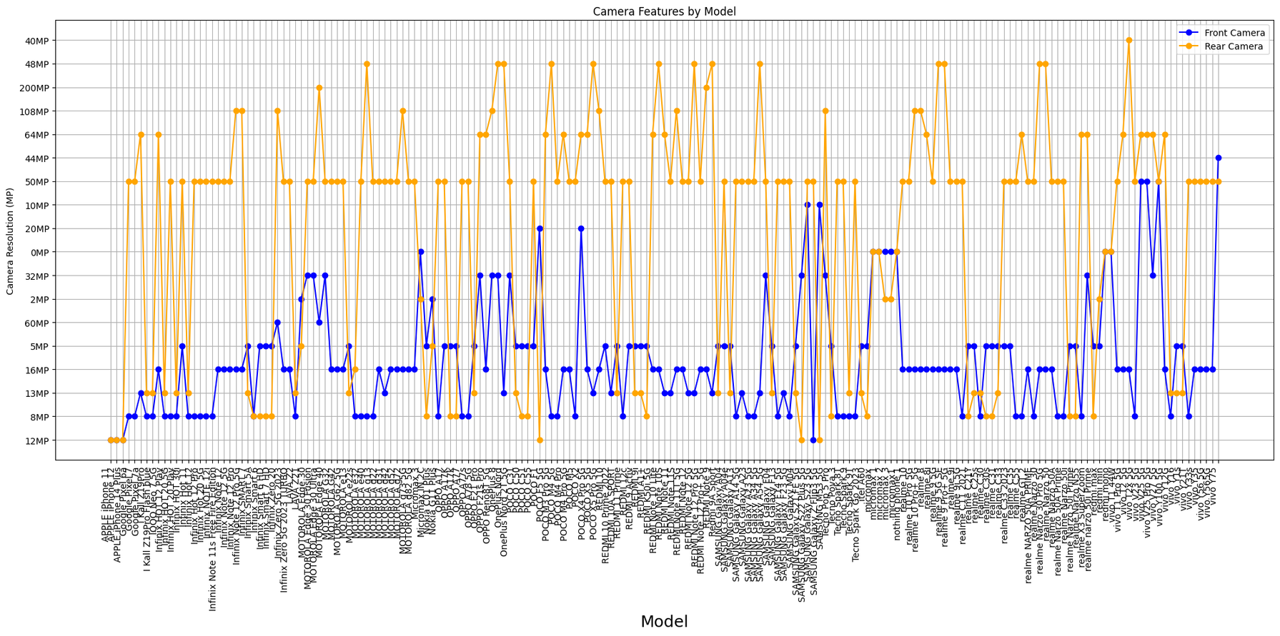
PROBLEM STATEMENT
WORKFLOW
DATA EXPLORATION
DATA
PRE-PROCESSING
FEATURE ANALYSIS
& EXTRACTION

Slide 6
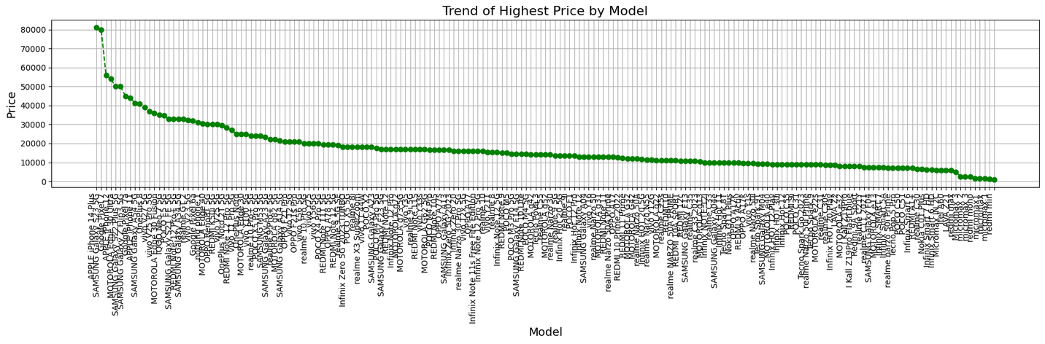
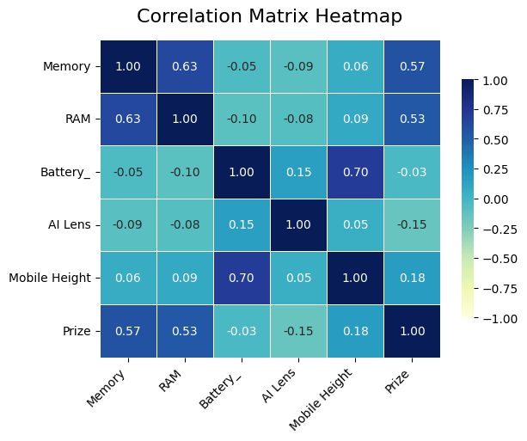
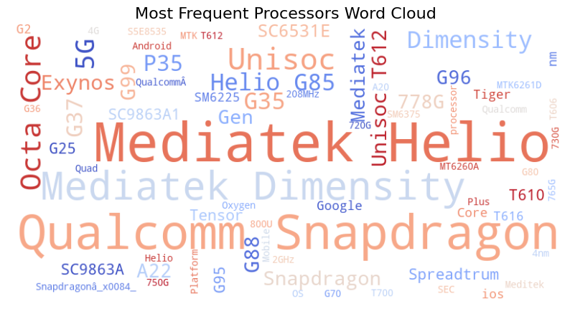
PROBLEM STATEMENT
WORKFLOW
DATA EXPLORATION
DATA
PRE-PROCESSING
FEATURE ANALYSIS
& EXTRACTION

Slide 7


PROBLEM STATEMENT
OUTLIERS
DATA GENERALIZATION
WORKFLOW
DATA EXPLORATION
i used box plot to visualize the outliers in each column.
instead of removing them, i segmented the main data into normal data and outlier data.
used z-scores to find outliers
There are unnecessary distinct values in color column. so, to make it simple, i generalized them into simple color (like white)
did same for processor and model column.
DATA
PRE-PROCESSING
FEATURE ANALYSIS
& EXTRACTION

Slide 8
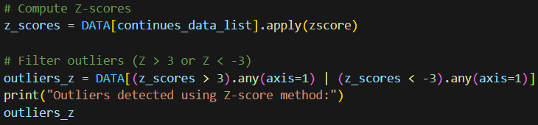
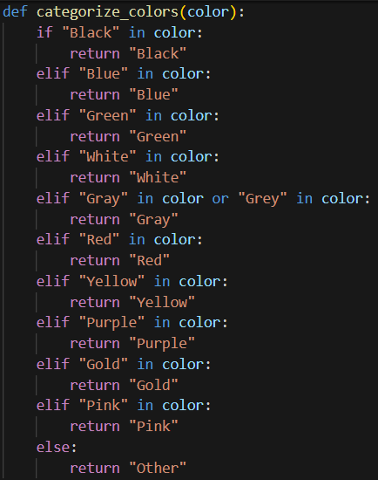


PROBLEM STATEMENT
WORKFLOW
DATA EXPLORATION
DATA
PRE-PROCESSING
FEATURE ANALYSIS
& EXTRACTION

Slide 9
PROBLEM STATEMENT
DATA ENCODING
WORKFLOW
As color column contains nominal categorical values, I used one-hot encoding.
Label encoding for processor column, as they show clear ordering.
also used label encoding for model column.
converted Boolean columns to integer.
performed numeric extraction in processor names column.
DATA EXPLORATION
DATA
PRE-PROCESSING
FEATURE ANALYSIS
& EXTRACTION

Slide 10

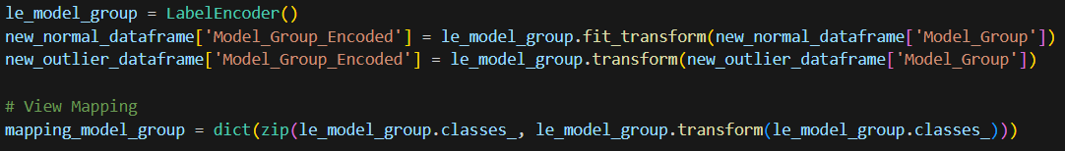
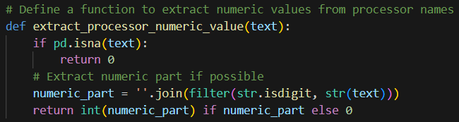
PROBLEM STATEMENT
WORKFLOW
DATA EXPLORATION
DATA
PRE-PROCESSING
FEATURE ANALYSIS
& EXTRACTION

Slide 11

PROBLEM STATEMENT
WORKFLOW
generated correlation matrix to get insights of feature relevance with respect of price column
Result: memory and RAM are higly correlated with price.
CORRELATION MATRIX
DATA EXPLORATION
PCA FOR
DIMENTIONALITY
REDUCTION
retained 95% variance from the data
Used imputers:
Numberical columns --> Simple imputer with mean
categorical columns --> Simple imputer with mode
DATA
PRE-PROCESSING
FEATURE ANALYSIS
& EXTRACTION

Slide 12
PROBLEM STATEMENT
WORKFLOW
used different feature selection techniques on data
RFE method
mutual information scores
lasso regression
FEATURE SELECTION
DATA EXPLORATION
DATA
PRE-PROCESSING
FEATURE ANALYSIS
& EXTRACTION

Slide 13
PROBLEM STATEMENT
WORKFLOW
used different feature selection techniques on data
RFE method
mutual information scores
lasso regression
FEATURE SELECTION
DATA EXPLORATION
DATA
PRE-PROCESSING
FEATURE ANALYSIS
& EXTRACTION

Slide 14
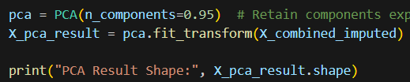
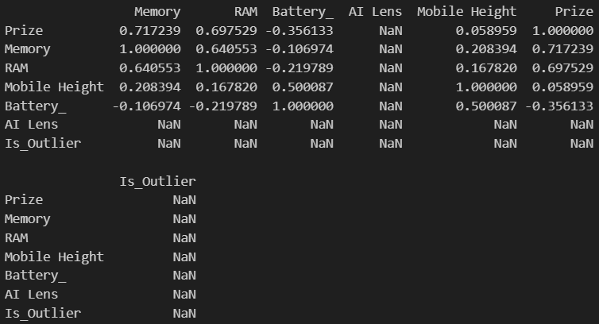
PROBLEM STATEMENT
WORKFLOW
DATA EXPLORATION
DATA
PRE-PROCESSING
FEATURE ANALYSIS
& EXTRACTION

Slide 15
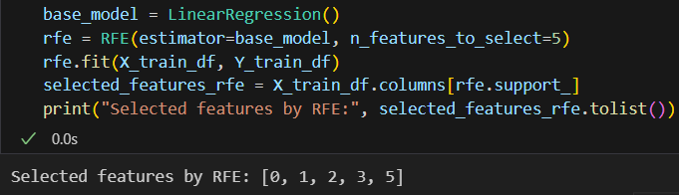
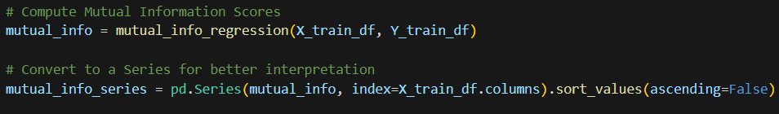
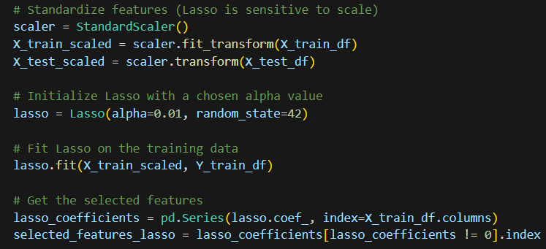
PROBLEM STATEMENT
WORKFLOW
DATA EXPLORATION
DATA
PRE-PROCESSING
FEATURE ANALYSIS
& EXTRACTION

Slide 16
MODEL BUILDING
DATA SPLIT
used 8:2 ration to split data between train and test
MODEL EVALUATION
Implemented linear regression model on pre-processed data using scikit-learn.
used R^2, MAE and RMSE as evaluation strategy to evaluate linear regression model
LINEAR REGRESSION
FEATURE IMPORTANCE
ANALUSIS
predicted price with the help of decision tree model.
used R^2 and MSE for model evaluation
performed hyper parameter tuning with gridSearchCV method to getr optimal paramerters
DIFFICULTIES
DECISION TREE
CONCLUSION

Slide 17
MODEL BUILDING
MODEL EVALUATION
used another tree based model to predict prices.
used R^2 and MSE for model evaluation
performed hyper parameter tuning with gridSearchCV method to get optimal parameters for random forest model
RANDOM FOREST
FEATURE IMPORTANCE
ANALUSIS
DIFFICULTIES
CONCLUSION

Slide 18
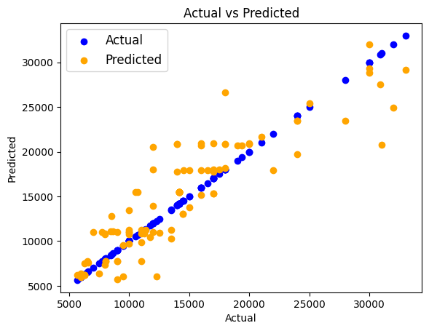
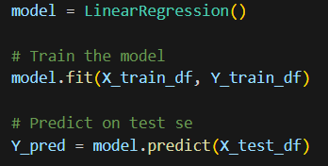
MODEL BUILDING
MODEL EVALUATION
FEATURE IMPORTANCE
ANALUSIS
DIFFICULTIES
CONCLUSION

Slide 19
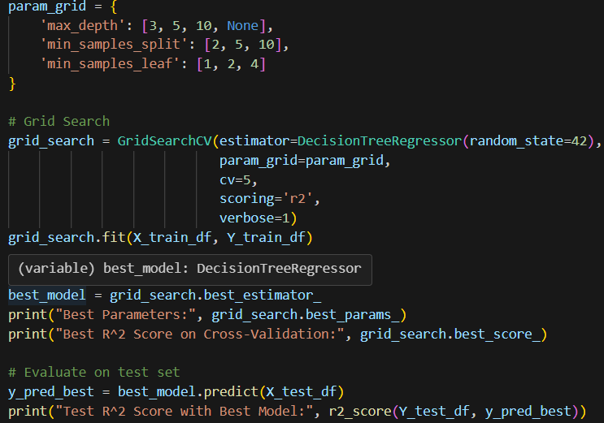
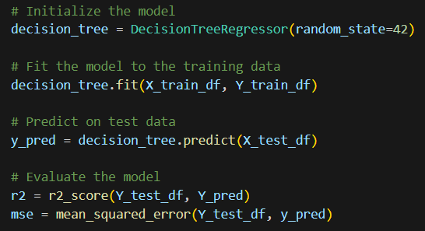
MODEL BUILDING
MODEL EVALUATION
FEATURE IMPORTANCE
ANALUSIS
DIFFICULTIES
CONCLUSION

Slide 20
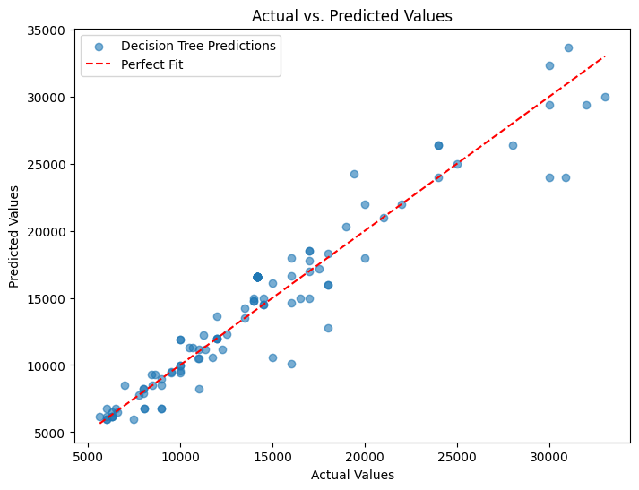
MODEL BUILDING
MODEL EVALUATION
FEATURE IMPORTANCE
ANALUSIS
DIFFICULTIES
CONCLUSION

Slide 21
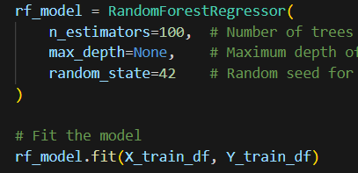
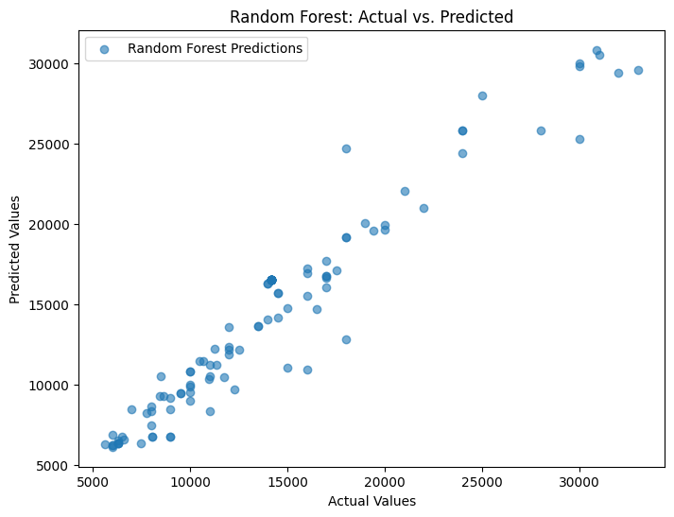
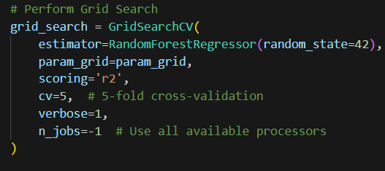
MODEL BUILDING
MODEL EVALUATION
FEATURE IMPORTANCE
ANALUSIS
DIFFICULTIES
CONCLUSION

Slide 22
MODEL BUILDING
MODEL EVALUATION
I used R square and Mean square error (MSE) to evaluate the model performance.
FEATURE IMPORTANCE
ANALUSIS
Linear Regression | Decision Tree | Random forest
0.789 | 0.789 | 0.9245
2959 | 3040235.69 | 3106771.54
R square
DIFFICULTIES
MSE
CONCLUSION

Slide 23
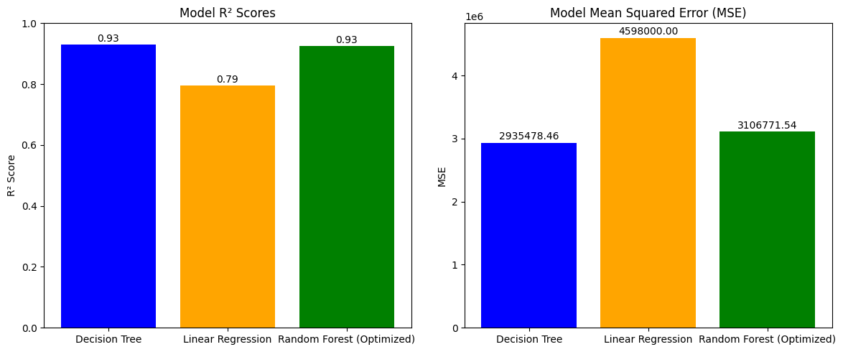
MODEL BUILDING
MODEL EVALUATION
FEATURE IMPORTANCE
ANALUSIS
DIFFICULTIES
CONCLUSION

Slide 24
MODEL BUILDING
MODEL EVALUATION
performed feature importance analysis on random forest model.
used bar chart to visualize the important feature.
analysis:
Memory is the most important feature
RAm is the second most important feature
FEATURE IMPORTANCE
ANALUSIS
DIFFICULTIES
CONCLUSION

Slide 25
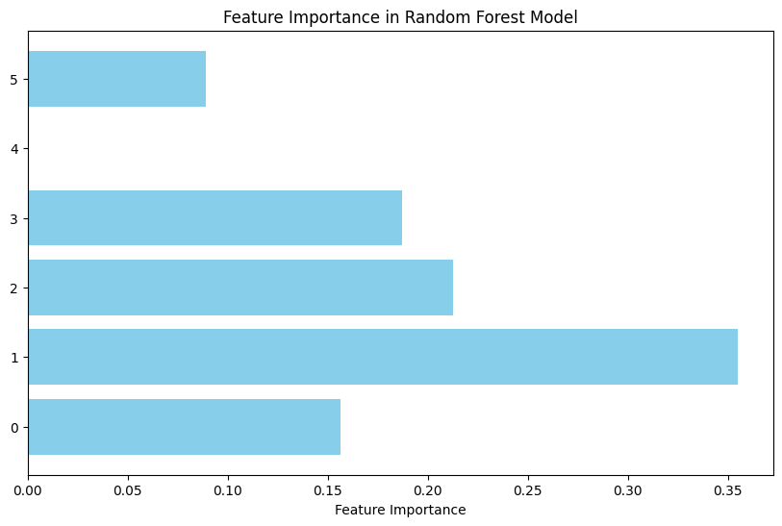
MODEL BUILDING
MODEL EVALUATION
FEATURE IMPORTANCE
ANALUSIS
DIFFICULTIES
CONCLUSION

Slide 26
MODEL BUILDING
MODEL EVALUATION
there is no null values in Dataset.
However, when i tried to separate the dataset for training and testing purpose, there were null values.
FEATURE IMPORTANCE
ANALUSIS
DIFFICULTIES
CONCLUSION

Slide 27

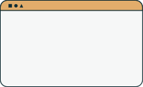


Random Forest showed best performance among all models with 0.93 R square score.
memory and RAM are most important features to predict prices.
CONCLUSION

Slide 28

THANK YOU
Presentation by Darshika Dudhat

